Slide 1
Healthy Catering Tips

Slide 2
Choose
An item from each group from “MyPlate”
Grains: whole grain
Protein: lean meats
Fruit: can be dessert!
Vegetable: half your plate!
Dairy: fat free or low fat

Slide 3
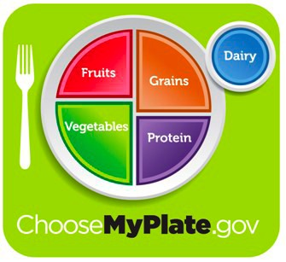

Slide 4
Choose a Grain
Whole wheat bread
Whole wheat pita
Whole wheat tortilla
Brown rice
Whole grain pasta
Whole grain pizza crust
Oatmeal
Quinoa
Bulgur
Popcorn
Barley
Millet

Slide 5
Choose a Protein
Turkey
Chicken
Eggs
Tuna
Nuts
Seeds
Beans
Legumes
Beef
Bison
Salmon

Slide 6
Choose as much fruit as you want
Fruit of all kinds!
Apples
Berries
Banana
Melon
Grapes
Citrus fruits
Pears
Kiwi
Pineapple
Peaches
Cherries

Slide 7
Choose as many vegetables as you want
Carrots
Celery
Tomato
Avocado
Cucumbers
Artichoke
Romaine
Spinach
Peppers
Onion
Pickles
Sprouts

Slide 8
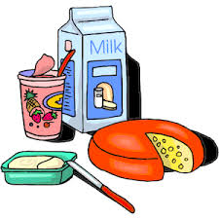
Choose a dairy
Milk
Cheese
Yogurt

Slide 9
Breakfast Ideas
Muffin tin quiches: egg, spinach, broccoli, cheese
Smoothies: vegetables & fruits
Yogurt parfait bar: Greek yogurt, fruit, granola
Oatmeal bar: raisins, flax, chia, or other fruit
Burrito bar: small tortillas, black beans, eggs, peppers, cheese
Sandwiches: whole grain, egg whites, turkey bacon or sausage.

Slide 10
Fast Food Breakfast Example
850 calories 37g fat
480 calories 8g fat
Egg w/ English muffin (290 calories)
Hashbrown (150 calories)
Medium mocha with whip cream (410)
Egg white sandwich (250)
Small nonfat mocha, no whip cream (230)
versus

Slide 11
What to choose?
Bagel w/ cream cheese
360 calories
Cinnamon roll
420 calories
Blueberry muffin
310 calories
Yogurt & granola parfait
150 calories
Fresh fruit cup
60 calories
Mini blueberry muffin
70 calories
versus

Slide 12
Lunch
Wraps: whole grain, lean meats
Sandwiches: whole grain breads, lean meats
Veggie Tray: go easy on the dipping sauce
Fruit as a side instead of chips
Salad Bar: with low fat dressings
Thin crust pizza: with tons of veggies
Taco bar: with low fat sides

Slide 13
Sub Shop Lunch Example
800 calories
335 calories
4” ham sandwich on Italian Herb & Cheese with cheese, lettuce, tomato, cucumbers, and yellow mustard (300 calories)
Peanut butter Cookie (220 calories)
Baked Lays (130 calories)
12oz coke (150 calories)
4” ham sandwich on Italian Herb & Cheese with cheese, lettuce, tomato, cucumbers, and yellow mustard (300 calories)
Apple Slices (35 calories)
Water
versus

Slide 14
Dinner
Try serving tapas so everyone can try a little of everything
If you can’t resist dessert, serve very small portions.
Have the servings already portioned out

Slide 15
Dinner Examples
Eggplant parmesan
Lasagna: lean meat and low fat cheese or vegetarian.
Mini meatloaves
Taco bar: small tortillas, black beans, vegetables, reduced fat cheese, and low fat sour cream,
Pasta bar: whole grain noodles, vegetables, and low fat sauce
Pair lean meats with vegetables!

Slide 16
Healthy Catering Tips
Small portions is the key
Provide only healthy choices
Provide vegetarian options
Choose lean meats
Try reduced fat or fat free products
Skip dessert or offer fruit!

Slide 17
Visit the webpage for further information
www.healthybydesignyellowstone.org
Or
“Like” Healthy By Design on Facebook

